Slide 1


Slide 2
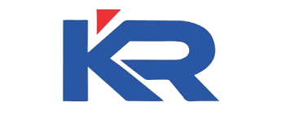

PROJECT REVIEW
GUIDED BY,
Mr. T. Siva Kumar M.E.,
TEAM MEMBERS,
1.Swathi.R (927622BEC226)
2.Swetha.K (927622BEC227)
3.Varshini.S (927622BEC242)

Slide 3
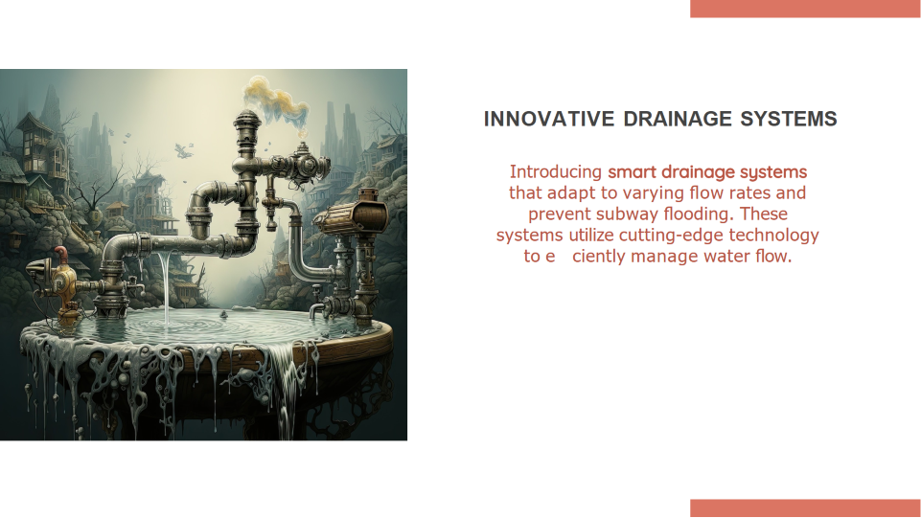
AN INTEGRATED SYSTEM FOR MANAGING WATER LEVEL IN SUBWAY FOR ACCIDENT PREVENTION

Slide 4
INTRODUCTION
Urban subway systems are crucial for efficient transportation, but they face challenges such as moisture management.
Our project aims to address these challenges through an integrated solution that enhances safety, efficiency, and passenger experience.

Slide 5
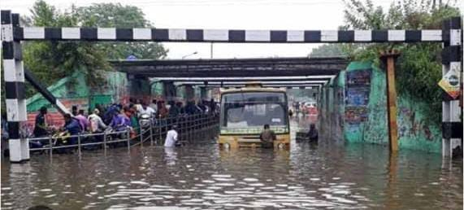
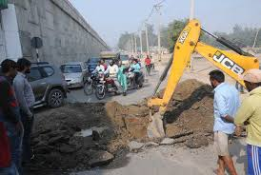
PROBLEM STATEMENT
Overflow of subway due to heavy rainfall.
Damaging of roads due to leakage in underground pipes.
Overflow of subway due to heavy rainfall and lack of infrastructure management

Slide 6
OBJECTIVE
Efficient Overflow Management
2. Enhanced Safety with Door Mechanism and Signal Notification
3. Sustainable Energy Generation with Piezoelectric Harvesting
4. Proactive Water Leakage Detection
5. Setting New Standards for Subway Infrastructure Management

Slide 7
EXISTING SYSTEM
Traditional subway management systems rely on manual interventions and reactive measures to address moisture-related challenges.
These systems often lack integrated solutions for managing moisture levels, drainage, and passenger safety.

Slide 8
Maintenance practices are typically based on periodic inspections rather than real-time monitoring, leading to increased downtime, operational costs, and safety risks.
In the event of moisture ingress or flooding, response actions are often delayed, resulting in disruptions to subway operations and potential damage to infrastructure.

Slide 9
PROPOSED SYSTEM
The proposed integrated subway infrastructure management system introduces a proactive approach to address moisture-related challenges.
It incorporates advanced technologies such as moisture and humidity sensors, piezoelectric energy harvesting flooring, automated drainage systems, and intelligent door mechanisms.

Slide 10
These components work collaboratively to detect moisture levels in real-time, optimize energy usage, manage water drainage efficiently, and enhance passenger safety.
By leveraging sensor technology, renewable energy harvesting, and automated control systems, the proposed system aims to minimize downtime, reduce operational costs, and mitigate environmental risks associated with moisture ingress in subway infrastructure.

Slide 11
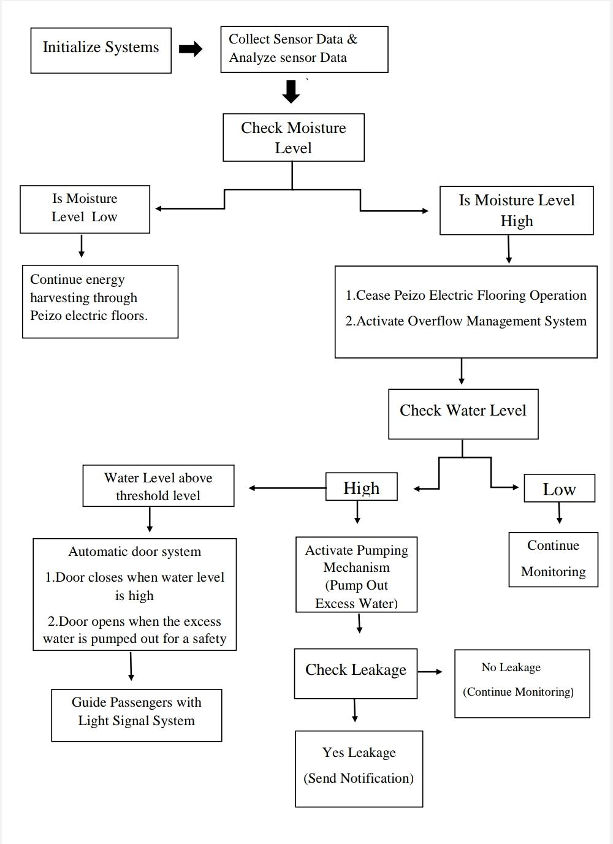
BLOCK DIAGRAM

Slide 12
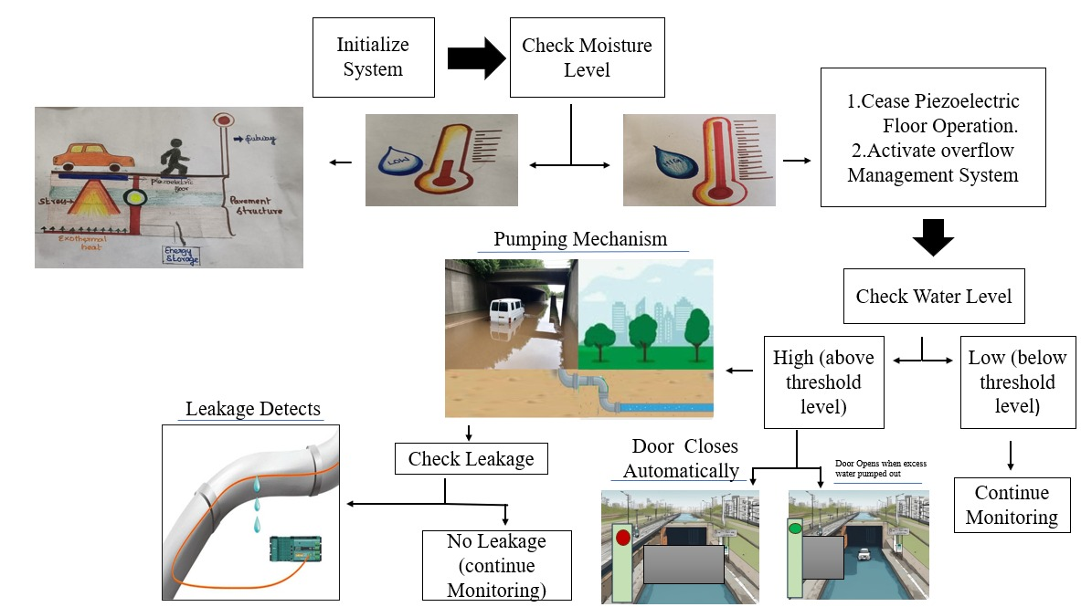
WORKING

Slide 13
CONCLUSION
Through the implementation of our integrated solution, we have demonstrated a significant improvement in urban subway infrastructure management.
By proactively addressing moisture-related challenges, enhancing passenger safety measures, optimizing energy usage, and minimizing environmental impact, our system outperforms existing methods.
This project sets a new standard for subway management, offering a more efficient, reliable, and sustainable approach to urban transportation infrastructure.

Slide 14


